Slide 1
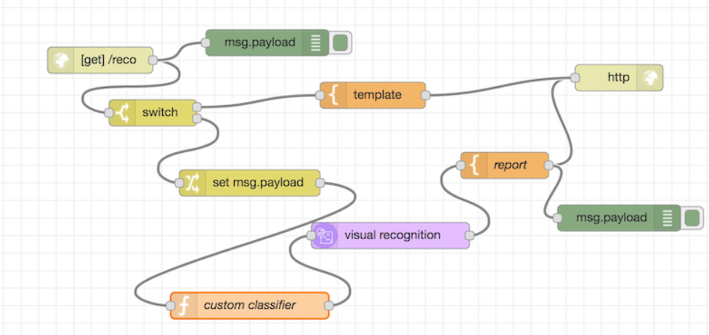
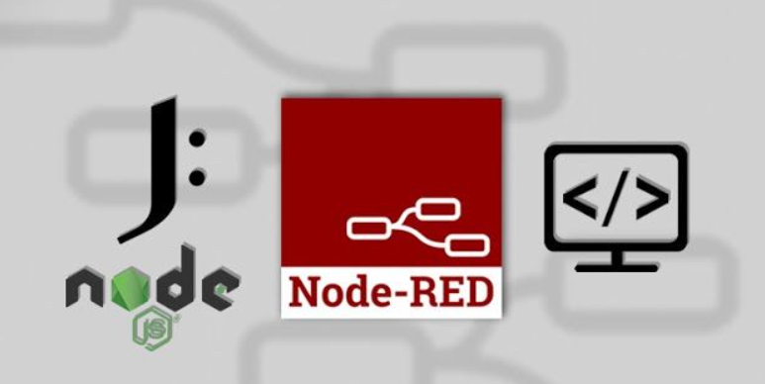
Introduction to Node-Red

Slide 2

Internet of Things (IoT)
IoT has huge potentials to establish new business
IoT Solutions
Predictive maintenance using sensor data
Telematics insurance based on driving data
Home automation
Problems
Collaboration with IT and OT (Operational Technology) engineers to validate values of the IoT Solutions
Trail and error style development difficulty because of sophisticated coding skills
Node-Red is one of the suitable development tools for IoT applications

Slide 3
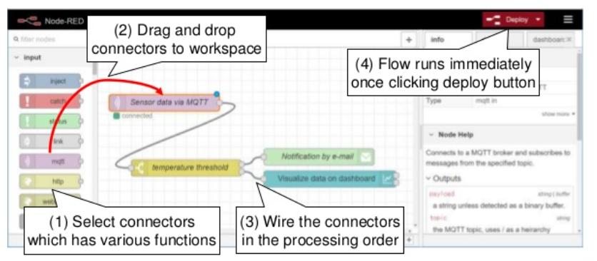
What is Node-Red?
Visual Programming tool for IoT applications
Flow based programming which realizes quick development
Various connectors (Node-Red nodes) to add functionalities
Open source software under Linux foundation

Slide 4
Node red is a Open Source flow based tool and IOT platform and Dashboard developed by IBM and written in Node.js.
Node-red lets you easily build applications by joining together black box functions (nodes) using a web interface, and it requires very little, if any, programming knowledge.
Node-RED has a built-in text editor, you can make applications as complex as you like by adding JavaScript functions.
Node-RED is based on Node.js and takes advantage of the event-driven, non-blocking model, it can be run on low-cost hardware like the Raspberry Pi or in the cloud.
Because of its flexibility and ease of use node-red is ideally suited for building IOT and Home control dashboards and automations as well as many other applications

Slide 5
Introduction Node.js
Node.js was created by Ryan Dahl starting in 2009, and its growth is sponsored by Joyent, his employer.
Node JS is a JavaScript framework invented to execute the code by interacting with the input and output.
Node's goal is to provide an easy way to build scalable network programs.

Slide 6
What is node.js ?
Node.js uses an event-driven, non-blocking I/O model that makes it lightweight and efficient, perfect for data-intensive real-time applications that run across distributed devices.
Node.js Runs on Google's V8 JavaScript Engine
Node.js programs are executed by V8 Java script engine the same used by Google chrome browser.
Node.js is used to build server side applications.
The Node.js platform provides abstractions that make it easier to create event-driven applications.
Node.js scales on a per processor basis as well as across servers.

Slide 7






Why to use Node?
Firstly, for performance and scalability.
Node can handle thousands of requests concurrently where PHP would just collapse.
Today it is used to power websites for LinkedIn, New York Times, PayPal, eBay, Walmart, Yahoo!, Intuit, Voxer and Uber, among other companies.

Slide 8
What is unique about Node.js?
JavaScript used in client-side but node.js puts the JavaScript on server-side thus making communication between client and server will happen in same language.
Servers are normally thread based but Node.JS is “Event” based. Node.JS serves each request in a Evented loop that can able to handle simultaneous requests.
Notes:
Thread based servers like Apache server will serve each web request as individual threads which doesn’t fit well for concurrent connections.

Slide 9
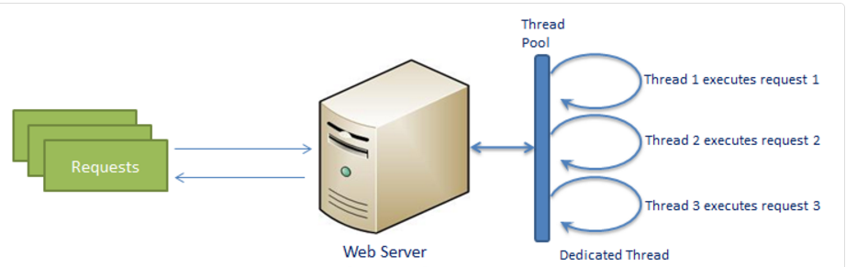
Traditional Web Server Model
In the traditional web server model, each request is handled by a dedicated thread from the thread pool. If no thread is available in the thread pool at any point of time then the request waits till the next available thread. Dedicated thread executes a particular request and does not return to thread pool until it completes the execution and returns a response.

Slide 10
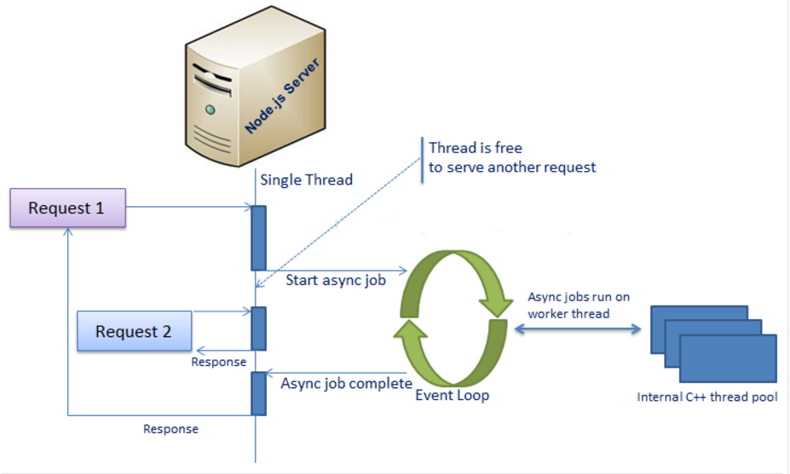
Node.js Process Model
Node.js processes user requests differently when compared to a traditional web server model. Node.js runs in a single process and the application code runs in a single thread and thereby needs less resources than other platforms. All the user requests to your web application will be handled by a single thread and all the I/O work or long running job is performed asynchronously for a particular request.

Slide 11
Why node.js use event-based?
In a normal process cycle, the web server while processing the request will have to wait for the IO operations and thus blocking the next request to be processed.
Node.JS process each request as events, The server doesn’t wait for the IO operation to complete while it can handle other request at the same time.
When the IO operation of first request is completed it will call-back the server to complete the request.

Slide 12
Understanding NPM
NPM is a package manager for Node JS.NPM is the pre-build libraries for Node JS. It was created in 2009 and it was introduced for Node JS in 2011. It is a public collection of packages of open source code for Node JS. NPM is command line client. Whenever you install Node JS, npm will automatically install in your system.
NPM is basically a repository of libraries you can use in your project like ruby has gems.
You can also use it just like npm install to install any packages and their dependencies in package.json

Slide 13
NPM: Introduction
npm makes it easy for JavaScript developers to share the code that they've created to solve particular problems, and for other developers to reuse that code in their own applications.
Once you're depending on this code from other developers, npm makes it really easy to check to see if they've made any updates to it, and to download those updates when they're made.
These bits of reusable code are called packages, or sometimes modules. A package is just a directory with one or more files in it, that also has a file called "package.json" with some metadata about this package.

Slide 14
Bootstrapping Application
In Node JS, Everything works in JSON.(Java Script Object Notation)
There is one main file which gives information about the application is package.json.
Create the folder for project using the command:
mkdir mynodejs_app
In Node JS, each application work like library/package so anyone can install and start working on it. Next, go to the folder mynodejs_app and execute the following command:
npm init
JSON is a collection of name/value pairs. In various languages, this is realized as an object, record, struct, dictionary, hash table, keyed list, or associative array.

Slide 15
package.json structure
package.json: Instructs the Node.js package manager (npm) what it needs to do; including which dependency packages should be installed.
1. name : (mynodejs_app) – It will take default name which is bracket if not entered. 2. version :(version number) – It will take default version if not entered. Better add version as it play vital role when you get bug. 3. description – Enter the description entry point : (index.js) – This is the default entry file which is called default. you can override with any file. 4. test command – Whenever you type “npm test”, what all set of command should be fire to test application. 5. git repository – if you are using Git Repository, you can enter here. So, you can easily deploy or update code on server. 6. keywords – You can add keywords matched with package. 7. author – Enter the name of author. 8. license :(ISC) – If you creating public package, what kind of licence applicable, you can enter here.
Refer this URL for more info: http://browsenpm.org/package.json#scripts

Slide 16
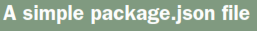
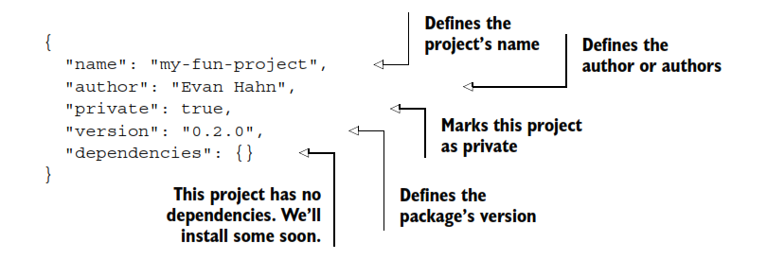

Slide 17
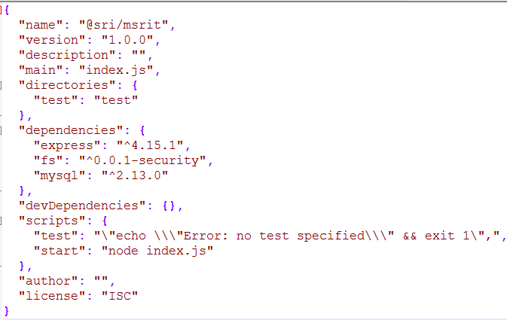
This will generate the JSON snippet and write it in the package.json file. It will ask for the confirmation. After that package.json file will be created in your application folder which contains following JSON information.
package.json

Slide 18
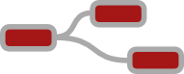
We have
Processors for editing Words
Spreadsheets for working with Numbers
Powerpoint for arranging Pictures and Ideas
But we don't have a simple tool for co-ordinating Events
Business events – status of processes, alerts from machines
Social events – tweets, alerts,
Internet of Things events – temperatures, weather, lights, doors
Something that anyone can use to build situational applications “Wouldn't it be neat if, when x happens it can tell me...
… and alert Fred...
… and kick off the xyz process...
… or just go ping !”

Slide 19
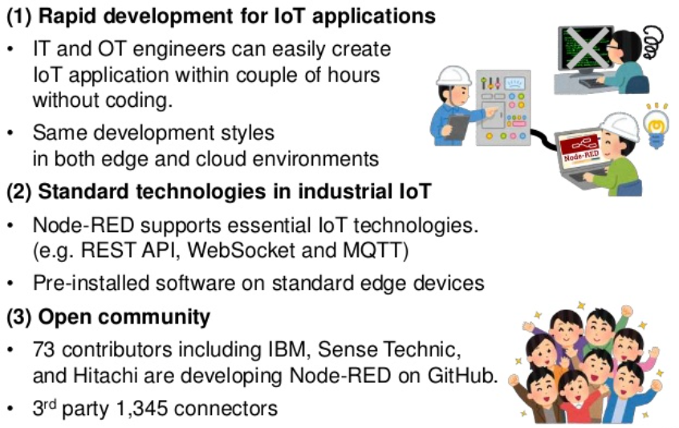
Why Node-Red?

Slide 20
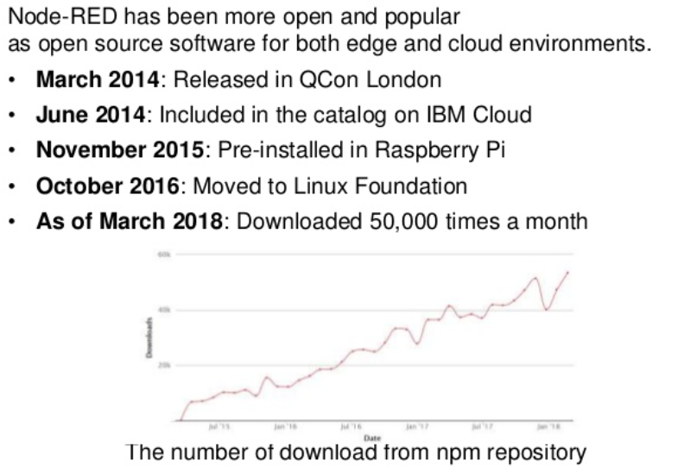
History of Node-Red

Slide 21
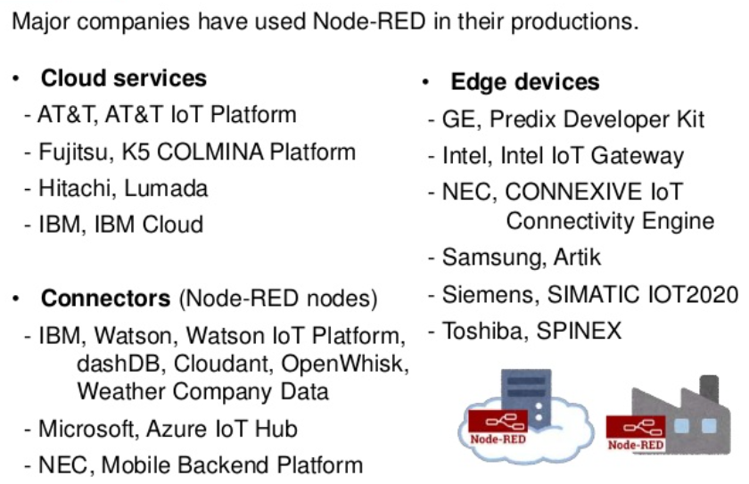
Who uses Node-Red?

Slide 22
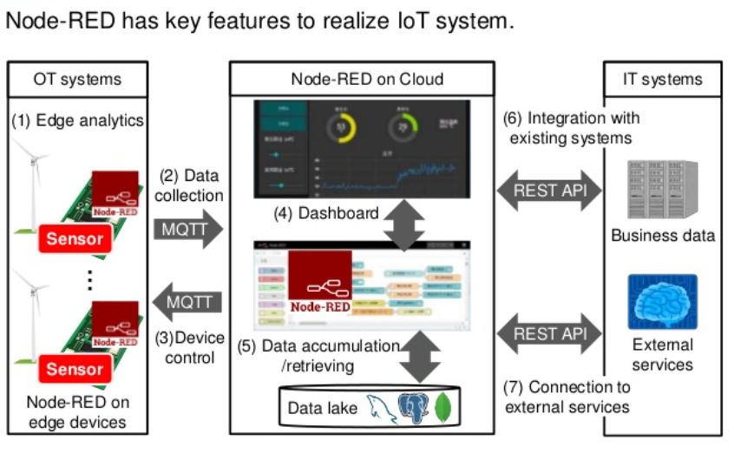
What does Node-Red realize?

Slide 23
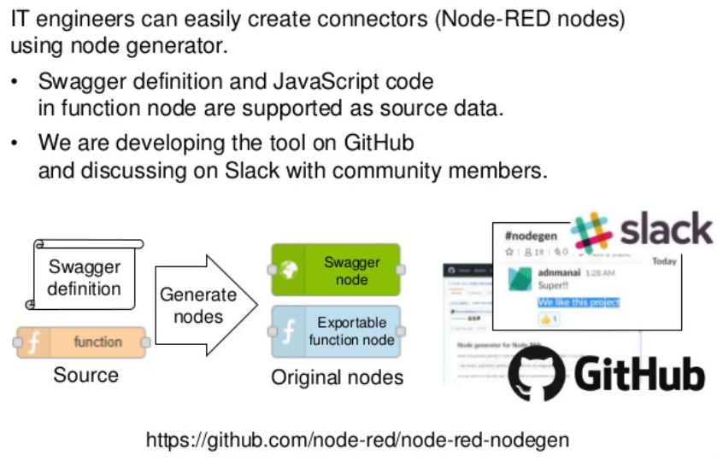
Is it difficult to connector a new connector?

Slide 24
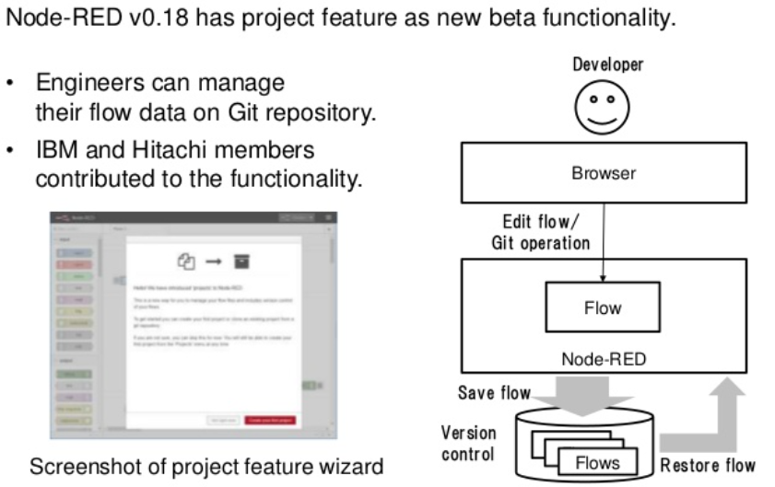
What is the latest feature in Node-Red?

Slide 25
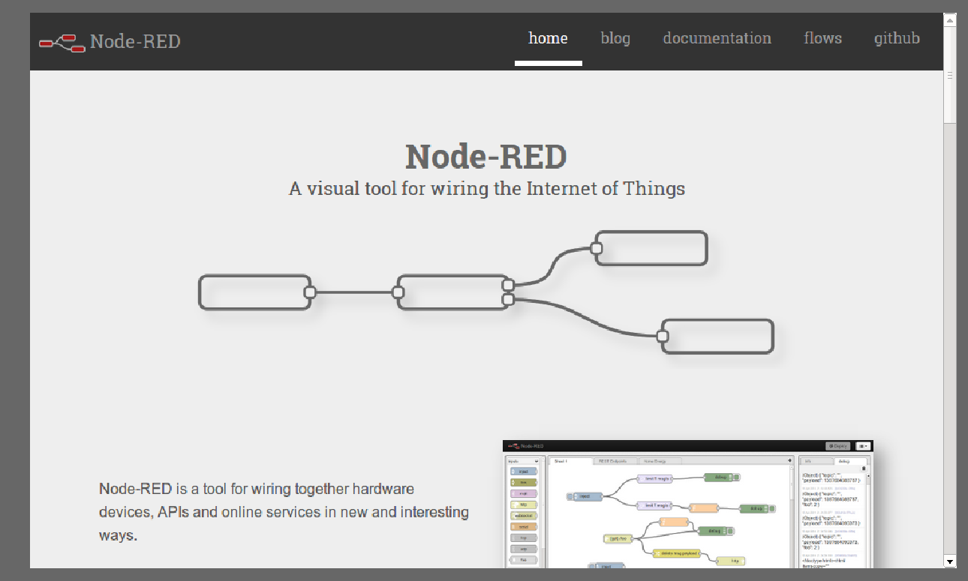

Slide 26
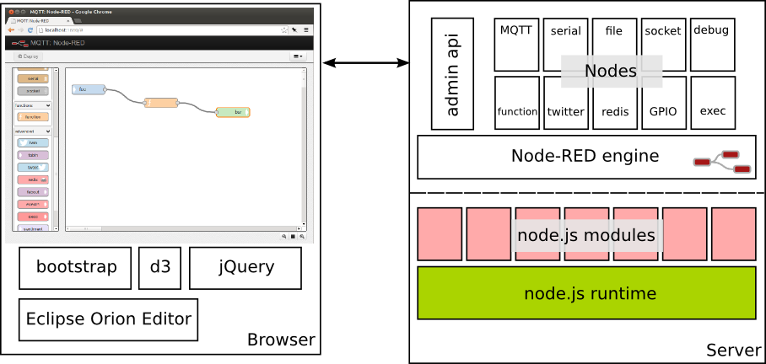
Architecture
Runs on node.js
Can exploit the 29,000+ open-source modules available via npm to add new functionality...
Node-RED nodes provide integration with other systems. Each node is defined in their own pair of JavaScript and html files using a simple API and are dynamically loaded by the engine.
Web interface can be secured or run headless.

Slide 27
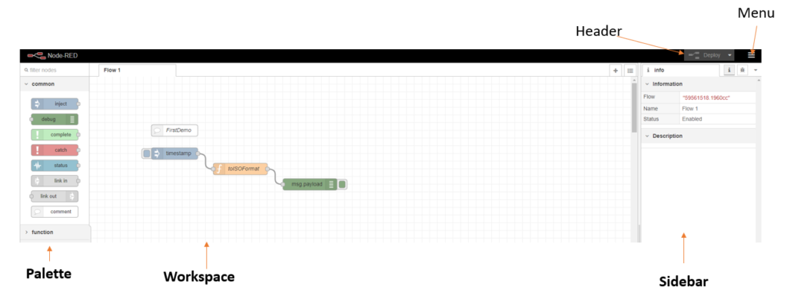
Node-RED Editor Components
Palette
List of all nodes you can use to create flows. These are separated into categories to keep them organized.
Workspace
This is where you create your workflows.
Header
Deploy button is what you click to take your current flow configuration and send it to the node-RED run-time.
Menu
Many useful features
Side-Bar
Number of Tabs with different tools.
Info Tab, Debug Tab (show messages passed to debug node), and Config Tab

Slide 28
The main pane is the flow creation workspace in the middle. This is where you drag and drop nodes and connect them with wires. Along the top of the workspace pane is a set of tabs. Each tab opens a previously created workspace and shows any flows created using that workspace.
left is the node pane that contains all the built-in nodes that your instance of Node-RED supports.
right-hand side is the output pane that can be toggled between the info and debug tabs. When info is selected, documentation for the selected node is shown there. When debug is selected, it will display the output of debug nodes, errors and warnings.

Slide 29
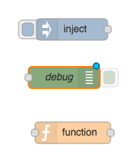
There are three main types of nodes:
Input Nodes (e.g. inject)
Output Nodes (e.g. debug)
Processing Nodes (e.g. function)

Slide 30
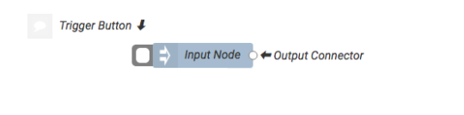
Input Nodes
These nodes will trigger the start of a flow and create the initial information packet. Input nodes typically get triggered from an external operation such as a HTTP request or a trigger button.
You can usually spot these nodes as they will have only a single connecting dot on the right-hand side (the output connector) and a missing connecting dot on the left (the input connector).
Therefore, you cannot connect two input nodes together as these nodes have no input connector.

Slide 31
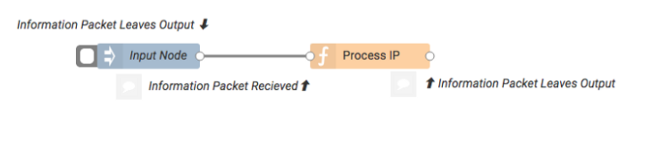
Function Nodes
Now that we have an input node, we need to pass the information packet to a function node so that we can process the request. These nodes have both an input connector and an output connector.
They receive the message on the input connector, execute the function using the information packet data for input then modify the information packet, sending it to the next node via the output connector.

Slide 32
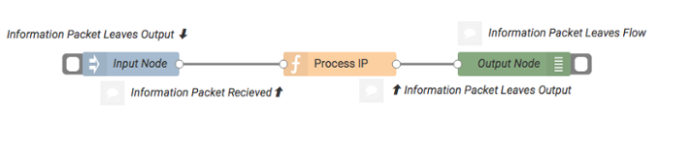
Output Nodes
The last type of node that we will look at is the output node. This node sends data out of your RedConnect app and can be spotted as it is missing the output connector.
In the example flow below we can see that the input node creates the IP, sends it to the function node for processing, which then sends the modified IP to the output node. Finally, the output node sends the packet out of RedConnect.

Slide 33
Node-RED nodes consume input messages and produce output messages. Messages are JavaScript objects that contain at least a “payload” parameter, like this:
A basic Node-RED message structure:
msg = {
payload:”message payload”
};

Slide 34
Nodes consume and produce messages, usually using msg.payload as the main placeholder for the data they consume and produce. However, messages can be extended to contain other parameters. For example, to set the topic of a message and add a new parameter, location, you could create a new msg object as shown
A more complex Node-RED message structure:
msg = {
payload:”message payload”,
topic:”error”,
location:”somewhere in space and time”
};

Slide 35
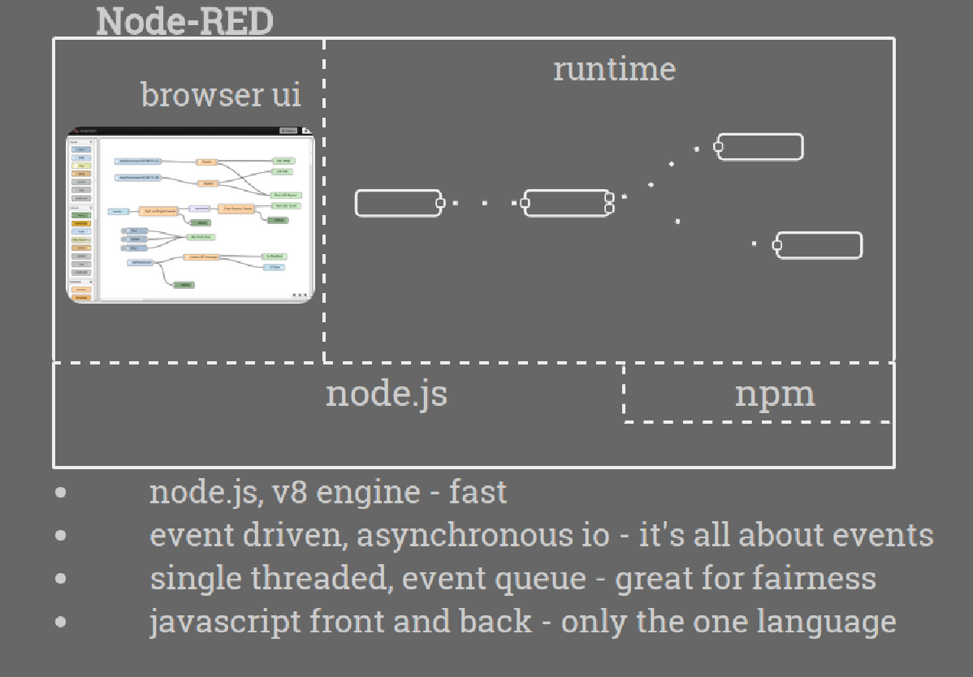

Slide 36
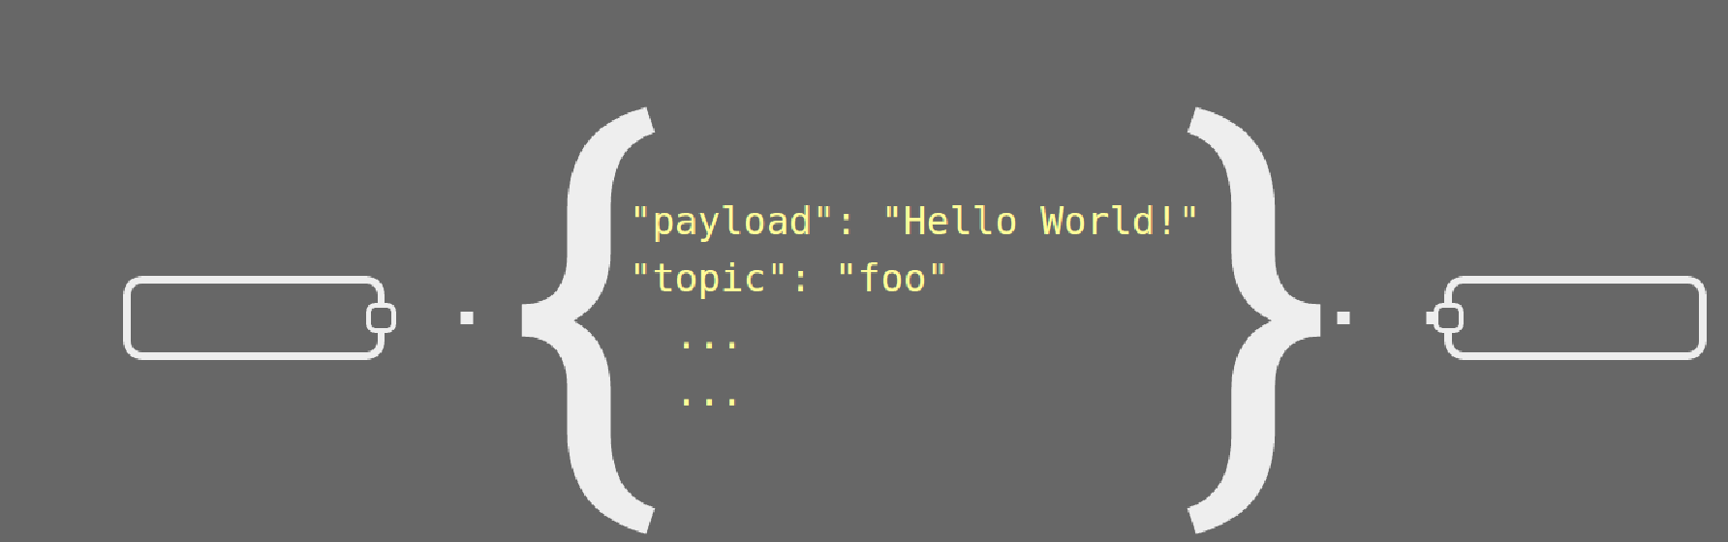

Slide 37
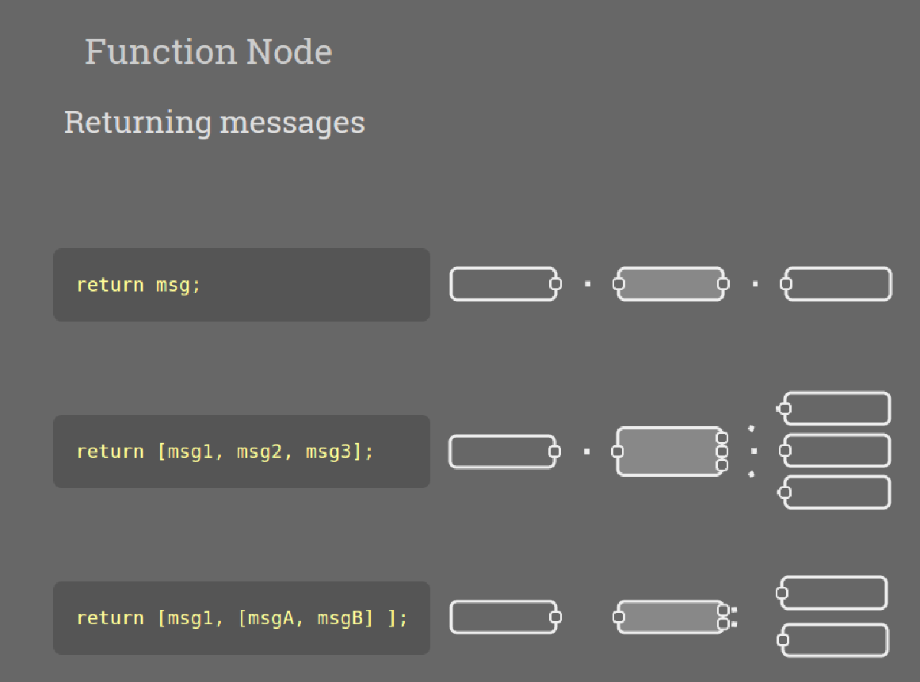

Slide 38
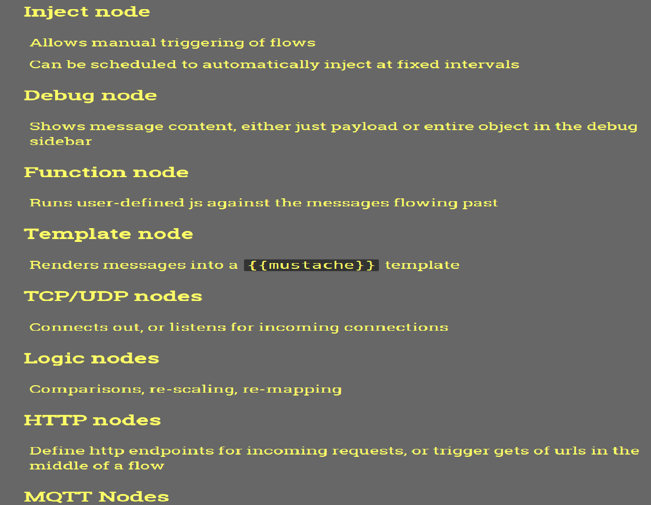

Slide 39
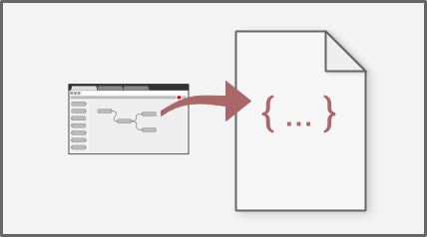
Social Development
The flows created in Node-RED are stored using JSON which can be easily imported and exported for sharing with others.
An online flow library allows you to share your best flows with the world.

Slide 40
Getting started
Prerequisites:
You need to have Node.js and npm installed.
Installation:
Getting Node-RED running globally is as easy as:
sudo npm install -g node-red

Slide 41
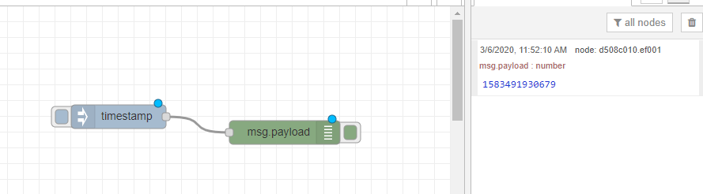
Create a Flow
The process of creating a flow involves adding Nodes to the workspace and wiring them together.:
Drag an inject node from the palette to the workspace. Inject-Node allows you to manually inject messages to flow.
Add a debug node.
Wire inject-node and debug-node together by clicking the output from inject-node to the input of debug-node.
Now, whenever the inject-node sends a message, it will be received by debug-node.
Click the Deploy button to push it to the runtime. Once deployed, click the button next to inject-node and check the debug-window for messages.

Slide 42
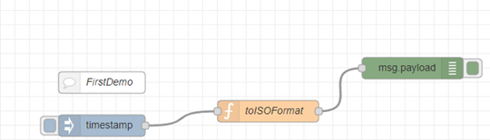
Function Node
The Function-Node allows you to write JavaScript, which will be executed for every message.
Add a function-node (toISOFormat) between the inject and debug node and write JavaScript as shown in the picture below.
Deploy and check the debug messages.

Slide 43
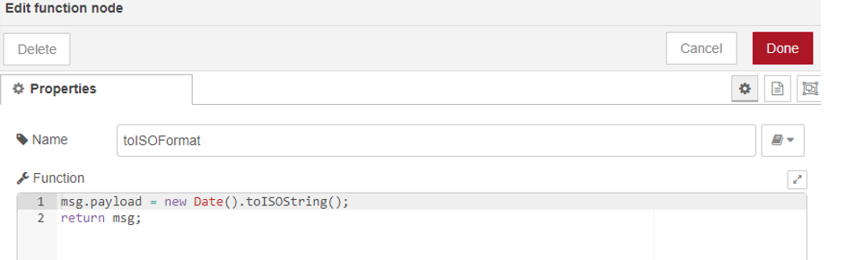
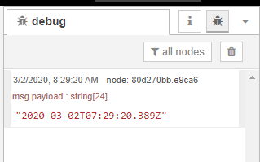
Here is the JavaScript code:
Once, deploy notice the change in debug messages:

Slide 44
First flow
Once Node-RED is running, you can access to it pointing your browser at http://localhost:1880.
You can always use a browser from another machine if you know the IP address or name of the Node-RED instance http://{Node-RED-machine-ip-address}:1880

Slide 45
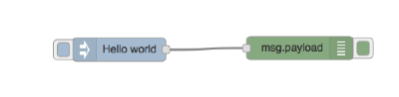
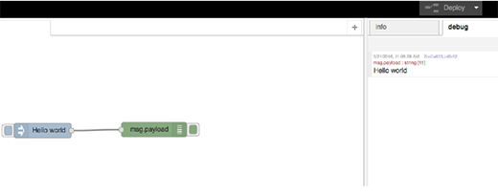
Insert an inject node:
Drag and drop an inject node on the flow editor, then double click and set up the payload as string and write "Hello world".
2. Insert a debug node:
Drag and drop the same way as you did with the inject node.
3. Wire them together as follows:
4. Deploy:
Click on the deploy button on the right corner.
5. Try it. You will see something like:

Slide 46
.
Step 1 - Add an Inject node
First, we need a way to start the flow. That’s one of the main purposes of the Inject node—to inject a message into the flow.
If it’s not open already, open Node-RED in your browser.
If using a groov EPIC processor, then open https://[groov-epic-hostname]/node-red
If using a groov Edge Appliance, then open https://[groov-box-hostname]:1880.
If using Node-RED running on your computer, you can use http://127.0.0.1:1880 or whichever address or hostname you’re using.
If you haven’t used Node-RED before, there should be one empty flow named “Flow 1”.
From the node palette on the left side of the Node-RED editor, select an Inject node and drag it onto the flow.
Double-click the node to open the “Edit inject node” view.
For the Payload field, select string and enter Hello, world! in the text field.
Click Done.
Later, with its msg.payload property set to “Hello, world!” this node is going to inject a message into the flow
http://developer.opto22.com/nodered/general/getting-started/node-red-hello-world/

Slide 47
Step 2 - Add a Debug node
We need a destination for the Inject node’s message. We’ll use the Debug node, which will print out our message to the debug console window.
From the node palette, select a Debug node and drag it onto the flow, and then place it to the right-hand side of the Inject node.
Wire the nodes together. Place the mouse cursor over the Inject node’s output port (a small gray square on the right-hand side of the node), then left-click and drag a wire over to the input port of the Debug node. A gray wire should now be connecting the output of the Inject node to the input of the Debug node.
The Debug node will automatically print the msg.payload property to the console window, which we’ll see in the next step.
http://developer.opto22.com/nodered/general/getting-started/node-red-hello-world/

Slide 48
Step 3 - Deploy and Run
Now that our flow is complete, we need to deploy it to the server and run it.
Click the Deploy button.
Click the Debug tab in the right-hand side of the editor window.
Click the Inject node’s button, which is the blue square coming out from the left-hand side of the Inject node. Clicking the button is what will inject a message into the flow.
A “Hello, world!” message should appear in the debug window.
Click the Inject node again to send another message.
http://developer.opto22.com/nodered/general/getting-started/node-red-hello-world/

Slide 49
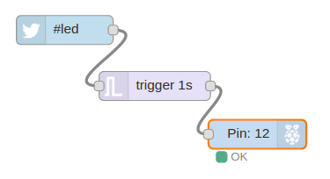
A simple 3 node flow that uses a Twitter tag to trigger a LED on a Raspberry PI.
The Twitter node is a built-in node in Node-RED and hides all of the complexity of using the Twitter API.
When the Twitter node sees the tag either in a tweet to the user, or the public tweet feed, it creates a new message with the details of the tweet, which is forwards to the next node in the flow.
The trigger node is another built-in node in Node-RED and its default behaviour is to wait for any message on its input. When it receives a message, it ‘triggers’, and sends a message on its output with the value “1” as the message body. It then waits 1 second and sends a second message with the value “0” in the message body.

Slide 50
Since the trigger node is connected to the gpionode, which controls the Input/Output or IO pins on the Raspberry PI, it get’s these two messages, 1 second apart, on its input.
If you have your PI wired up with an LED connected to Pin 12, the gpionode going high for 1 second and then low will cause the LED to blink on for 1 second.

Slide 51
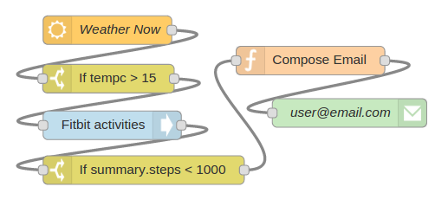
Using Node-RED to alert you when you’re falling behind on your exercise schedule
A simple flow to alert you when you are not exercising and the weather is good:

Slide 52
openweather node which you can configure to check the weather for any major city at set intervals. When it checks, it packages up the results in a message which is forwarded to the next node, in this case, to a switch node.
The switch node performs a simple test, checking the input message for a value and sending a message with a value of “1” if the test is true. In our case, it’s been configured to test the temperature value (tempc) to see if it’s 15 degrees celsius or higher.
When the switch node tests to true, or ‘switches on’, it sends a message onto the fitbit node which is the next node in the flow.
The fitbit node is another powerful built-in node that you can configure to get statistics on your fitbit device from the fitbit.com portal. The fitbit node packages the statistics for your device into a message and forwards it to the next node in the flow.
The next node is another switch node. This one has been configured to check if the number of steps you’ve walked today is less than 1000. It does this by testing to see if the fitbit data field, summary.steps, is less than 1000.
If you have walked less than 1000 steps today, then the switch node generates a message that is passed on through the flow to a function node. The function node is a generic all-purpose node that allows you to write your own programming logic in Javascript.
Once this message is created within the function node, it is sent through the flow to the final node which is an email node. This node will take the body of any incoming message and send it to the email account configured when the node is initialized.

Slide 53
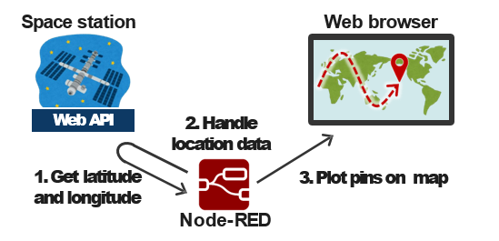
Demo: Tracking space station on map
Node-RED can easily get data via web API and visualize it on the browser
Demo: Get location of space station and plot it on map

Slide 54
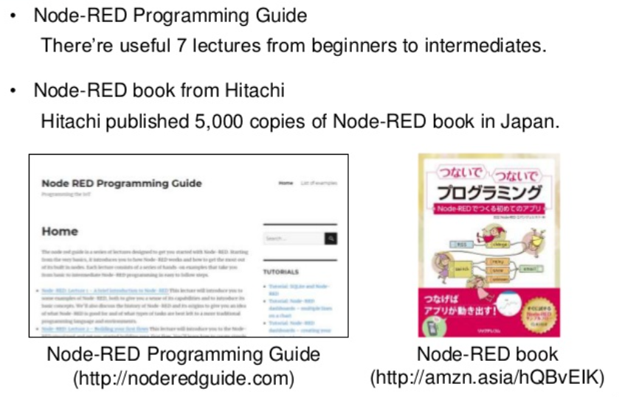
How to learn Node-Red?

